Slide 1
Building Java Programs Chapter 8
Classes
Copyright (c) Pearson 2013. All rights reserved.

Slide 2
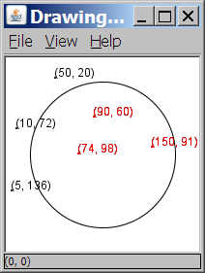
A programming problem
Given a file of cities' (x, y) coordinates, which begins with the number of cities:
6
50 20
90 60
10 72
74 98
5 136
150 91
Write a program to draw the cities on a DrawingPanel, then drop a "bomb" that turns all cities red that are within a given radius:
Blast site x? 100
Blast site y? 100
Blast radius? 75
Kaboom!

Slide 3
A bad solution
Scanner input = new Scanner(new File("cities.txt"));
int cityCount = input.nextInt();
int[] xCoords = new int[cityCount];
int[] yCoords = new int[cityCount];
for (int i = 0; i < cityCount; i++) {
xCoords[i] = input.nextInt(); // read each city
yCoords[i] = input.nextInt();
}
...
parallel arrays: 2+ arrays with related data at same indexes.
Considered poor style.

Slide 4
Observations
The data in this problem is a set of points.
It would be better stored as Point objects.
A Point would store a city's x/y data.
We could compare distances between Points to see whether the bomb hit a given city.
Each Point would know how to draw itself.
The overall program would be shorter and cleaner.

Slide 5

Clients of objects
client program: A program that uses objects.
Example: Bomb is a client of DrawingPanel and Graphics.
Bomb.java (client program)
public class Bomb {
main(String[] args) {
new DrawingPanel(...)
new DrawingPanel(...)
...
}
}
DrawingPanel.java (class)
public class DrawingPanel {
...
}

Slide 6
Classes and objects
class: A program entity that represents either:
1. A program / module, or
2. A template for a new type of objects.
The DrawingPanel class is a template for creating DrawingPanel objects.
object: An entity that combines state and behavior.
object-oriented programming (OOP): Programs that perform their behavior as interactions between objects.

Slide 7
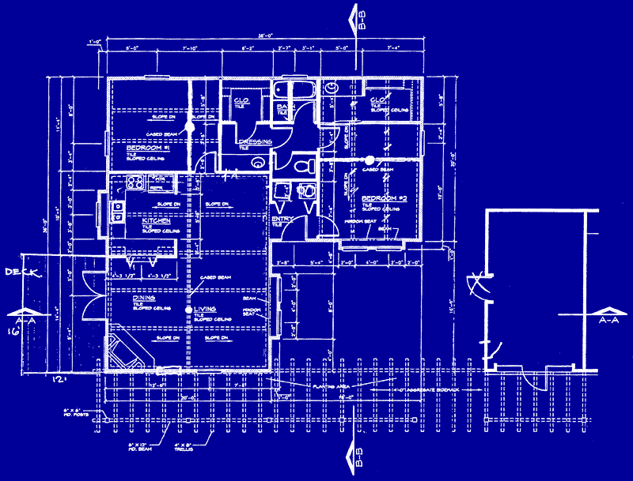
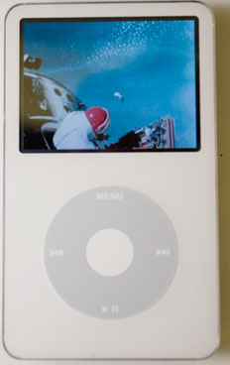
Blueprint analogy
iPod blueprint
state: current song volume battery life
behavior: power on/off change station/song change volume choose random song
creates
iPod #1
state: song = "1,000,000 Miles" volume = 17 battery life = 2.5 hrs
behavior: power on/off change station/song change volume choose random song
iPod #2
state: song = "Letting You" volume = 9 battery life = 3.41 hrs
behavior: power on/off change station/song change volume choose random song
iPod #3
state: song = "Discipline" volume = 24 battery life = 1.8 hrs
behavior: power on/off change station/song change volume choose random song

Slide 8
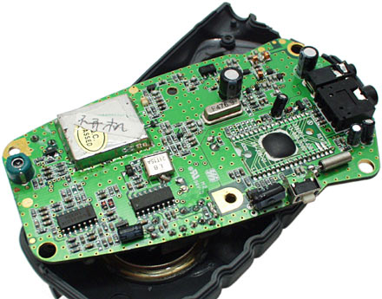
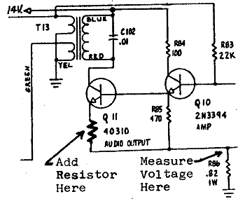
Abstraction
abstraction: A distancing between ideas and details.
We can use objects without knowing how they work.
abstraction in an iPod:
You understand its external behavior (buttons, screen).
You don't understand its inner details, and you don't need to.

Slide 9
Our task
In the following slides, we will implement a Point class as a way of learning about defining classes.
We will define a type of objects named Point.
Each Point object will contain x/y data called fields.
Each Point object will contain behavior called methods.
Client programs will use the Point objects.

Slide 10
Point objects (desired)
Point p1 = new Point(5, -2);
Point p2 = new Point(); // origin, (0, 0)
Data in each Point object:
Methods in each Point object:
Field name | Description
x | the point's x-coordinate
y | the point's y-coordinate
Method name | Description
setLocation(x, y) | sets the point's x and y to the given values
translate(dx, dy) | adjusts the point's x and y by the given amounts
distance(p) | how far away the point is from point p
draw(g) | displays the point on a drawing panel

Slide 11
Point class as blueprint
The class (blueprint) will describe how to create objects.
Each object will contain its own data and methods.
Point class
state: int x, y
behavior: setLocation(int x, int y) translate(int dx, int dy) distance(Point p) draw(Graphics g)
Point object #1
state: x = 5, y = -2
behavior: setLocation(int x, int y) translate(int dx, int dy) distance(Point p) draw(Graphics g)
Point object #2
state: x = -245, y = 1897
behavior: setLocation(int x, int y) translate(int dx, int dy) distance(Point p) draw(Graphics g)
Point object #3
state: x = 18, y = 42
behavior: setLocation(int x, int y) translate(int dx, int dy) distance(Point p) draw(Graphics g)

Slide 12
Object state: Fields

Slide 13
Point class, version 1
public class Point {
int x;
int y;
}
Save this code into a file named Point.java.
The above code creates a new type named Point.
Each Point object contains two pieces of data:
an int named x, and
an int named y.
Point objects do not contain any behavior (yet).

Slide 14
Fields
field: A variable inside an object that is part of its state.
Each object has its own copy of each field.
Declaration syntax:
type name;
Example:
public class Student {
String name; // each Student object has a
double gpa; // name and gpa field
}

Slide 15
Accessing fields
Other classes can access/modify an object's fields.
access: variable.field
modify: variable.field = value;
Example:
Point p1 = new Point();
Point p2 = new Point();
System.out.println("the x-coord is " + p1.x); // access
p2.y = 13; // modify

Slide 16
A class and its client
Point.java is not, by itself, a runnable program.
A class can be used by client programs.
Point.java (class of objects)
public class Point {
int x;
int y;
}
PointMain.java (client program)
public class PointMain {
main(String args) {
Point p1 = new Point();
p1.x = 7;
p1.y = 2;
Point p2 = new Point();
p2.x = 4;
p2.y = 3;
...
}
}
x | 7 | y | 2
x | 4 | y | 3

Slide 17
PointMain client example
public class PointMain {
public static void main(String[] args) {
// create two Point objects
Point p1 = new Point();
p1.y = 2;
Point p2 = new Point();
p2.x = 4;
System.out.println(p1.x + ", " + p1.y); // 0, 2
// move p2 and then print it
p2.x += 2;
p2.y++;
System.out.println(p2.x + ", " + p2.y); // 6, 1
}
}
Exercise: Modify the Bomb program to use Point objects.

Slide 18
Arrays of objects
null : A value that does not refer to any object.
The elements of an array of objects are initialized to null.
String[] words = new String[5];
DrawingPanel[] windows = new DrawingPanel[3];
index | 0 | 1 | 2 | 3 | 4
value | null | null | null | null | null
words
index | 0 | 1 | 2
value | null | null | null
windows

Slide 19
Things you can do w/ null
store null in a variable or an array element
String s = null;
words[2] = null;
print a null reference
System.out.println(s); // null
ask whether a variable or array element is null
if (words[2] == null) { ...
pass null as a parameter to a method
System.out.println(null); // null
return null from a method (often to indicate failure)
return null;

Slide 20
Null pointer exception
dereference: To access data or methods of an object with the dot notation, such as s.length() .
It is illegal to dereference null (causes an exception).
null is not any object, so it has no methods or data.
String[] words = new String[5];
System.out.println("word is: " + words[0]);
words[0] = words[0].toUpperCase(); // ERROR
Output:
word is: null
Exception in thread "main" java.lang.NullPointerException
at Example.main(Example.java:8)
index | 0 | 1 | 2 | 3 | 4
value | null | null | null | null | null

Slide 21
Looking before you leap
You can check for null before calling an object's methods.
String[] words = new String[5];
words[0] = "hello";
words[2] = "goodbye"; // words[1], [3], [4] are null
for (int i = 0; i < words.length; i++) {
if (words[i] != null) {
words[i] = words[i].toUpperCase();
}
}
index | 0 | 1 | 2 | 3 | 4
value | "HELLO" | null | "GOODBYE" | null | null
words

Slide 22
Two-phase initialization
1) initialize the array itself (each element is initially null)
2) initialize each element of the array to be a new object
String[] words = new String[4]; // phase 1
for (int i = 0; i < words.length; i++) {
coords[i] = "word" + i; // phase 2
}
index | 0 | 1 | 2 | 3
value | "word0" | "word1" | "word2" | "word3"
words

Slide 23
Bomb answer 1
import java.awt.*;
import java.io.*;
import java.util.*;
// Displays a set of cities and simulates dropping a "bomb" on them.
public class Bomb {
public static void main(String[] args) throws FileNotFoundException {
DrawingPanel panel = new DrawingPanel(200, 200);
Graphics g = panel.getGraphics();
Scanner input = new Scanner(new File("cities.txt"));
Point[] cities = readCities(input, g);
// drop the "bomb"
Scanner console = new Scanner(System.in);
Point bomb = new Point();
System.out.print("Blast site x? ");
bomb.x = console.nextInt();
System.out.print("Blast site y? ");
bomb.y = console.nextInt();
System.out.print("Blast radius? ");
int radius = console.nextInt();
boom(bomb, radius, cities, g);
}
...

Slide 24
Bomb answer 2
// Reads input file of cities and returns them as array of Points.
public static Point[] readCities(Scanner input, Graphics g) {
int numCities = input.nextInt(); // first line = # of cities
Point[] cities = new Point[numCities];
for (int i = 0; i < cities.length; i++) {
cities[i] = new Point();
cities[i].x = input.nextInt(); // read city x/y from file
cities[i].y = input.nextInt();
g.fillOval(cities[i].x, cities[i].y, 3, 3);
g.drawString("(" + cities[i].x + ", " + cities[i].y + ")",
cities[i].x, cities[i].y);
}
return cities;
}
// Simulates dropping a bomb at the given location on the given cities.
public static void boom(Point bomb, int radius, Point[] cities, Graphics g) {
g.setColor(Color.RED);
g.drawOval(bomb.x - radius, bomb.y - radius, 2 * radius, 2 * radius);
for (int i = 0; i < cities.length; i++) {
int dx = cities[i].x - bomb.x;
int dy = cities[i].y - bomb.y;
double distance = Math.sqrt(dx * dx + dy * dy);
if (distance <= radius) {
g.fillOval(cities[i].x, cities[i].y, 3, 3);
g.drawString("(" + cities[i].x + ", " + cities[i].y + ")",
cities[i].x, cities[i].y);
}
}
System.out.println("Kaboom!");
}
}

Slide 25
Object behavior: Methods

Slide 26
Client code redundancy
Our client program wants to draw Point objects:
// draw each city
g.fillOval(cities[i].x, cities[i].y, 3, 3);
g.drawString("(" + cities[i].x + ", " + cities[i].y + ")",
cities[i].x, cities[i].y);
To draw them in other places, the code must be repeated.
We can remove this redundancy using a method.

Slide 27
Eliminating redundancy, v1
We can eliminate the redundancy with a static method:
// Draws the given point on the DrawingPanel.
public static void draw(Point p, Graphics g) {
g.fillOval(p.x, p.y, 3, 3);
g.drawString("(" + p.x + ", " + p.y + ")", p.x, p.y);
}
main would call the method as follows:
// draw each city
draw(cities[i], g);

Slide 28
Problem with static method
We are missing a major benefit of objects: code reuse.
Every program that draws Points would need a draw method.
The syntax doesn't match how we're used to using objects.
draw(cities[i], g); // static (bad)
The point of classes is to combine state and behavior.
The draw behavior is closely related to a Point's data.
The method belongs inside each Point object.
cities[i].draw(g); // inside object (better)

Slide 29
Instance methods
instance method (or object method): Exists inside each object of a class and gives behavior to each object.
public type name(parameters) {
statements;
}
same syntax as static methods, but without static keyword
Example:
public void shout() {
System.out.println("HELLO THERE!");
}

Slide 30
Instance method example
public class Point {
int x;
int y;
// Draws this Point object with the given pen.
public void draw(Graphics g) {
...
}
}
The draw method no longer has a Point p parameter.
How will the method know which point to draw?
How will the method access that point's x/y data?

Slide 31
Point objects w/ method
Each Point object has its own copy of the draw method, which operates on that object's state:
Point p1 = new Point();
p1.x = 7;
p1.y = 2;
Point p2 = new Point();
p2.x = 4;
p2.y = 3;
p1.draw(g);
p2.draw(g);
p1
public void draw(Graphics g) {
// this code can see p1's x and y
}
x | 7 | y | 2
public void draw(Graphics g) {
// this code can see p2's x and y
}
x | 4 | y | 3
p2

Slide 32
The implicit parameter
implicit parameter: The object on which an instance method is called.
During the call p1.draw(g); the object referred to by p1 is the implicit parameter.
During the call p2.draw(g); the object referred to by p2 is the implicit parameter.
The instance method can refer to that object's fields.
We say that it executes in the context of a particular object.
draw can refer to the x and y of the object it was called on.

Slide 33
Point class, version 2
public class Point {
int x;
int y;
// Changes the location of this Point object.
public void draw(Graphics g) {
g.fillOval(x, y, 3, 3);
g.drawString("(" + x + ", " + y + ")", x, y);
}
}
Each Point object contains a draw method that draws that point at its current x/y position.

Slide 34
Kinds of methods
accessor: A method that lets clients examine object state.
Examples: distance, distanceFromOrigin
often has a non-void return type
mutator: A method that modifies an object's state.
Examples: setLocation, translate

Slide 35
Mutator method questions
Write a method setLocation that changes a Point's location to the (x, y) values passed.
Write a method translate that changes a Point's location by a given dx, dy amount.
Modify the Point and client code to use these methods.

Slide 36
Mutator method answers
public void setLocation(int newX, int newY) {
x = newX;
y = newY;
}
public void translate(int dx, int dy) {
x = x + dx;
y = y + dy;
}
// alternative solution that utilizes setLocation
public void translate(int dx, int dy) {
setLocation(x + dx, y + dy);
}

Slide 37
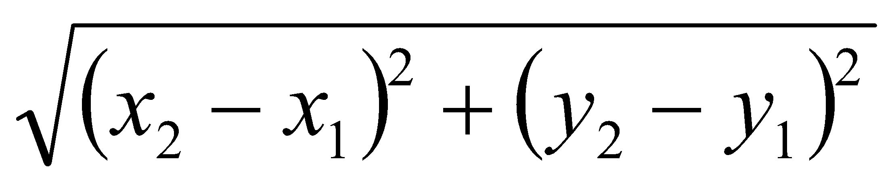
Accessor method questions
Write a method distance that computes the distance between a Point and another Point parameter.
Use the formula:
Write a method distanceFromOrigin that returns the distance between a Point and the origin, (0, 0).
Modify the client code to use these methods.

Slide 38
Accessor method answers
public double distance(Point other) {
int dx = x - other.x;
int dy = y - other.y;
return Math.sqrt(dx * dx + dy * dy);
}
public double distanceFromOrigin() {
return Math.sqrt(x * x + y * y);
}
// alternative solution that uses distance
public double distanceFromOrigin() {
Point origin = new Point();
return distance(origin);
}

Slide 39
Printing objects
By default, Java doesn't know how to print objects:
Point p = new Point();
p.x = 10;
p.y = 7;
System.out.println("p is " + p); // p is Point@9e8c34
// better, but cumbersome; p is (10, 7)
System.out.println("p is (" + p.x + ", " + p.y + ")");
// desired behavior
System.out.println("p is " + p); // p is (10, 7)

Slide 40
The toString method
tells Java how to convert an object into a String
Point p1 = new Point(7, 2);
System.out.println("p1: " + p1);
// the above code is really calling the following:
System.out.println("p1: " + p1.toString());
Every class has a toString, even if it isn't in your code.
Default: class's name @ object's memory address (base 16)
Point@9e8c34

Slide 41
toString syntax
public String toString() {
code that returns a String representing this object;
}
Method name, return, and parameters must match exactly.
Example:
// Returns a String representing this Point.
public String toString() {
return "(" + x + ", " + y + ")";
}

Slide 42
Object initialization: constructors

Slide 43
Initializing objects
Currently it takes 3 lines to create a Point and initialize it:
Point p = new Point();
p.x = 3;
p.y = 8; // tedious
We'd rather specify the fields' initial values at the start:
Point p = new Point(3, 8); // better!
We are able to this with most types of objects in Java.

Slide 44
Constructors
constructor: Initializes the state of new objects.
public type(parameters) {
statements;
}
runs when the client uses the new keyword
no return type is specified; it implicitly "returns" the new object being created
If a class has no constructor, Java gives it a default constructor with no parameters that sets all fields to 0.

Slide 45
Constructor example
public class Point {
int x;
int y;
// Constructs a Point at the given x/y location.
public Point(int initialX, int initialY) {
x = initialX;
y = initialY;
}
public void translate(int dx, int dy) {
x = x + dx;
y = y + dy;
}
...
}

Slide 46
Tracing a constructor call
What happens when the following call is made?
Point p1 = new Point(7, 2);
public Point(int initialX, int initialY) {
x = initialX;
y = initialY;
}
public void translate(int dx, int dy) {
x += dx;
y += dy;
}
p1
x |  | y

Slide 47
Client code, version 3
public class PointMain3 {
public static void main(String[] args) {
// create two Point objects
Point p1 = new Point(5, 2);
Point p2 = new Point(4, 3);
// print each point
System.out.println("p1: (" + p1.x + ", " + p1.y + ")");
System.out.println("p2: (" + p2.x + ", " + p2.y + ")");
// move p2 and then print it again
p2.translate(2, 4);
System.out.println("p2: (" + p2.x + ", " + p2.y + ")");
}
}
OUTPUT:
p1: (5, 2)
p2: (4, 3)
p2: (6, 7)

Slide 48
Multiple constructors
A class can have multiple constructors.
Each one must accept a unique set of parameters.
Exercise: Write a Point constructor with no parameters that initializes the point to (0, 0).
// Constructs a new point at (0, 0).
public Point() {
x = 0;
y = 0;
}

Slide 49
Common constructor bugs
1. Re-declaring fields as local variables ("shadowing"):
public Point(int initialX, int initialY) {
int x = initialX;
int y = initialY;
}
This declares local variables with the same name as the fields, rather than storing values into the fields. The fields remain 0.
2. Accidentally giving the constructor a return type:
public void Point(int initialX, int initialY) {
x = initialX;
y = initialY;
}
This is actually not a constructor, but a method named Point

Slide 50
Encapsulation

Slide 51
Encapsulation
encapsulation: Hiding implementation details from clients.
Encapsulation forces abstraction.
separates external view (behavior) from internal view (state)
protects the integrity of an object's data

Slide 52
Private fields
A field that cannot be accessed from outside the class
private type name;
Examples:
private int id;
private String name;
Client code won't compile if it accesses private fields:
PointMain.java:11: x has private access in Point
System.out.println(p1.x);
^

Slide 53
Accessing private state
// A "read-only" access to the x field ("accessor")
public int getX() {
return x;
}
// Allows clients to change the x field ("mutator")
public void setX(int newX) {
x = newX;
}
Client code will look more like this:
System.out.println(p1.getX());
p1.setX(14);

Slide 54
Point class, version 4
// A Point object represents an (x, y) location.
public class Point {
private int x;
private int y;
public Point(int initialX, int initialY) {
x = initialX;
y = initialY;
}
public int getX() {
return x;
}
public int getY() {
return y;
}
public double distanceFromOrigin() {
return Math.sqrt(x * x + y * y);
}
public void setLocation(int newX, int newY) {
x = newX;
y = newY;
}
public void translate(int dx, int dy) {
setLocation(x + dx, y + dy);
}
}

Slide 55
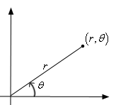
Benefits of encapsulation
Abstraction between object and clients
Protects object from unwanted access
Example: Can't fraudulently increase an Account's balance.
Can change the class implementation later
Example: Point could be rewritten in polar coordinates (r, θ) with the same methods.
Can constrain objects' state (invariants)
Example: Only allow Accounts with non-negative balance.
Example: Only allow Dates with a month from 1-12.

Slide 56
The this keyword
this : Refers to the implicit parameter inside your class.
(a variable that stores the object on which a method is called)
Refer to a field: this.field
Call a method: this.method(parameters);
One constructor this(parameters); can call another:

Slide 57
Variable shadowing
shadowing: 2 variables with same name in same scope.
Normally illegal, except when one variable is a field.
public class Point {
private int x;
private int y;
...
// this is legal
public void setLocation(int x, int y) {
...
}
In most of the class, x and y refer to the fields.
In setLocation, x and y refer to the method's parameters.

Slide 58
Fixing shadowing
public class Point {
private int x;
private int y;
...
public void setLocation(int x, int y) {
this.x = x;
this.y = y;
}
}
Inside setLocation,
To refer to the data field x, say this.x
To refer to the parameter x, say x

Slide 59
Calling another constructor
public class Point {
private int x;
private int y;
public Point() {
this(0, 0); // calls (x, y) constructor
}
public Point(int x, int y) {
this.x = x;
this.y = y;
}
...
}
Avoids redundancy between constructors
Only a constructor (not a method) can call another constructor

Slide 60
Static methods/fields

Slide 61
Multi-class systems
Most large software systems consist of many classes.
One main class runs and calls methods of the others.
Advantages:
code reuse
splits up the program logic into manageable chunks
Main Class #1
main
method1
method2
Class #2
method3
method5
Class #3
method4
method6

Slide 62
Redundant program 1
// This program sees whether some interesting numbers are prime.
public class Primes1 {
public static void main(String[] args) {
int[] nums = {1234517, 859501, 53, 142};
for (int i = 0; i < nums.length; i++) {
if (isPrime(nums[i])) {
System.out.println(nums[i] + " is prime");
}
}
}
// Returns the number of factors of the given integer.
public static int countFactors(int number) {
int count = 0;
for (int i = 1; i <= number; i++) {
if (number % i == 0) {
count++; // i is a factor of the number
}
}
return count;
}
// Returns true if the given number is prime.
public static boolean isPrime(int number) {
return countFactors(number) == 2;
}
}

Slide 63
Redundant program 2
// This program prints all prime numbers up to a maximum.
public class Primes2 {
public static void main(String[] args) {
Scanner console = new Scanner(System.in);
System.out.print("Max number? ");
int max = console.nextInt();
for (int i = 2; i <= max; i++) {
if (isPrime(i)) {
System.out.print(i + " ");
} }
System.out.println();
}
// Returns true if the given number is prime.
public static boolean isPrime(int number) {
return countFactors(number) == 2;
}
// Returns the number of factors of the given integer.
public static int countFactors(int number) {
int count = 0;
for (int i = 1; i <= number; i++) {
if (number % i == 0) {
count++; // i is a factor of the number
} }
return count;
}
}

Slide 64
Classes as modules
module: A reusable piece of software, stored as a class.
Example module classes: Math, Arrays, System
// This class is a module that contains useful methods
// related to factors and prime numbers.
public class Factors {
// Returns the number of factors of the given integer.
public static int countFactors(int number) {
int count = 0;
for (int i = 1; i <= number; i++) {
if (number % i == 0) {
count++; // i is a factor of the number
}
}
return count;
}
// Returns true if the given number is prime.
public static boolean isPrime(int number) {
return countFactors(number) == 2;
}
}

Slide 65
More about modules
A module is a partial program, not a complete program.
It does not have a main. You don't run it directly.
Modules are meant to be utilized by other client classes.
Syntax:
class.method(parameters);
Example:
int factorsOf24 = Factors.countFactors(24);

Slide 66
Using a module
// This program sees whether some interesting numbers are prime.
public class Primes {
public static void main(String[] args) {
int[] nums = {1234517, 859501, 53, 142};
for (int i = 0; i < nums.length; i++) {
if (Factors.isPrime(nums[i])) {
System.out.println(nums[i] + " is prime");
}
}
}
}
// This program prints all prime numbers up to a given maximum.
public class Primes2 {
public static void main(String[] args) {
Scanner console = new Scanner(System.in);
System.out.print("Max number? ");
int max = console.nextInt();
for (int i = 2; i <= max; i++) {
if (Factors.isPrime(i)) {
System.out.print(i + " ");
} }
System.out.println();
}
}

Slide 67
Modules in Java libraries
// Java's built in Math class is a module
public class Math {
public static final double PI = 3.14159265358979323846;
...
public static int abs(int a) {
if (a >= 0) {
return a;
} else {
return -a;
}
}
public static double toDegrees(double radians) {
return radians * 180 / PI;
}
}
Notes:
You can even open the code for Math.java in the Java src.zip install file in the JDK folder.

Slide 68
Static members
static: Part of a class, rather than part of an object.
Object classes can have static methods and fields.
Not copied into each object; shared by all objects of that class.
class
state: private static int staticFieldA private static String staticFieldB
behavior: public static void someStaticMethodC() public static void someStaticMethodD()
object #1
state: int field2 double field2
behavior: public void method3() public int method4() public void method5()
object #2
state: int field1 double field2
behavior: public void method3() public int method4() public void method5()
object #3
state: int field1 double field2
behavior: public void method3() public int method4() public void method5()

Slide 69
Static fields
private static type name;
or,
private static type name = value;
Example:
private static int theAnswer = 42;
static field: Stored in the class instead of each object.
A "shared" global field that all objects can access and modify.
Like a class constant, except that its value can be changed.

Slide 70
Accessing static fields
From inside the class where the field was declared:
fieldName // get the value
fieldName = value; // set the value
From another class (if the field is public):
ClassName.fieldName // get the value
ClassName.fieldName = value; // set the value
generally static fields are not public unless they are final
Exercise: Modify the BankAccount class shown previously so that each account is automatically given a unique ID.
Exercise: Write the working version of FratGuy.

Slide 71
BankAccount solution
public class BankAccount {
// static count of how many accounts are created
// (only one count shared for the whole class)
private static int objectCount = 0;
// fields (replicated for each object)
private String name;
private int id;
public BankAccount() {
objectCount++; // advance the id, and
id = objectCount; // give number to account
}
...
public int getID() { // return this account's id
return id;
}
}

Slide 72
Static methods
// the same syntax you've already used for methods
public static type name(parameters) {
statements;
}
static method: Stored in a class, not in an object.
Shared by all objects of the class, not replicated.
Does not have any implicit parameter, this; therefore, cannot access any particular object's fields.
Exercise: Make it so that clients can find out how many total BankAccount objects have ever been created.

Slide 73
BankAccount solution
public class BankAccount {
// static count of how many accounts are created
// (only one count shared for the whole class)
private static int objectCount = 0;
// clients can call this to find out # accounts created
public static int getNumAccounts() {
return objectCount;
}
// fields (replicated for each object)
private String name;
private int id;
public BankAccount() {
objectCount++; // advance the id, and
id = objectCount; // give number to account
}
...
public int getID() { // return this account's id
return id;
}
}

Slide 74
Summary of Java classes
A class is used for any of the following in a large program:
a program : Has a main and perhaps other static methods.
example: GuessingGame, Birthday, MadLibs, CritterMain
does not usually declare any static fields (except final)
an object class : Defines a new type of objects.
example: Point, BankAccount, Date, Critter, FratGuy
declares object fields, constructor(s), and methods
might declare static fields or methods, but these are less of a focus
should be encapsulated (all fields and static fields private)
a module : Utility code implemented as static methods.
example: Math

